Slide 1
Revolutionizing Cardiac Health: AI-Driven ECG Analysis

Slide 2
Our Motivation
Our journey in this endeavor is deeply rooted in personal experiences and the collective desire to make a tangible difference. For instance, my first hand experience in screening young athletes which opened my eyes to the profound community impact of sudden cardiac arrest (SCA). Witnessing the ripple effect of such events has been both a sobering and motivating force.
While these experiences are part of our individual stories, they are not the sole focus. Instead, they serve as catalysts that drive our commitment to innovation in cardiac health. Our goal is not to center the narrative around us, but to use our personal motivations as a springboard to create solutions that benefit communities worldwide.
We care because we've seen the need. We care because we believe in the potential of our AI software to prevent tragedies and enhance lives. And we care because, at the heart of it, we are committed to turning our shared vision into a reality that transcends individual stories and touches lives globally.

Slide 3
Introduction (WHY)
Hypertrophic Cardiomyopathy (HCM):
Genetic condition causing abnormal thickening of the heart muscle.
Affects 1 in 500 individuals globally.
Can lead to sudden cardiac death, especially in young athletes.
Diagnostic Challenges
Asymptomatic Nature: Often undetected due to lack of symptoms.
Athlete's Heart vs. HCM: Differentiating benign athletic heart adaptations from HCM is complex.
Importance of Early Detection
Prevent Complications: Timely diagnosis can prevent atrial fibrillation and related risks like stroke.
Management and Safety: Allows for proper medical care and informed decisions regarding sports participation.

Slide 4
The Gap in Current Solutions (WHY)
Current Diagnostic Techniques
Invasive: Many techniques, like cardiac catheterization, are invasive.
Cost and Accessibility: High costs and limited availability in low-resource settings.
Complexity: Requires specialized knowledge and equipment.
Needs for Improvement
Accessibility: A non-invasive, affordable tool can increase access to diagnosis.
Accuracy: Enhanced precision is crucial for distinguishing between HCM and conditions like athlete's heart.
Patient Safety: Early detection can improve patient outcomes and safety.
Supporting Data
Underdiagnosis: An estimated 75% of individuals with HCM remain undiagnosed.
Economic Burden: The high cost of advanced diagnostics limits widespread use.
Mortality Rates: HCM is the most common cause of sudden cardiac death in young athletes.

Slide 5
Our Solution: AI-Driven ECG Analysis
(WHAT)
AI in 12-Lead ECG Analysis
Innovation: AI, particularly computer vision, offers a novel approach to interpreting 12-lead ECG images.
Efficiency: Automates the analysis process, potentially reducing diagnosis time.
Differentiating HCM with AI and Severity Estimation
Precision: AI can distinguish HCM from similar conditions like athlete's heart with high accuracy.
AI Accuracy: Utilizes unique ECG patterns to differentiate HCM from conditions like athlete's heart.
Feature Recognition: AI identifies key features like LV cavity size and T-wave inversion, crucial for accurate diagnosis.
Severity Analysis: AI models can estimate the severity of HCM, aiding in prognosis and treatment planning.

Slide 6
Technological Innovation (WHAT)
Innovative CNN Architecture for HCM Diagnosis
Robust CNN Model: Employs deep layers to analyze 12-lead ECG images for HCM markers.
Guideline-Informed Features: Integrates NIH research and medical guidelines for precise feature selection.
Novel Diagnostic Tool: Represents a groundbreaking approach in non-invasive HCM detection using AI.

Slide 7
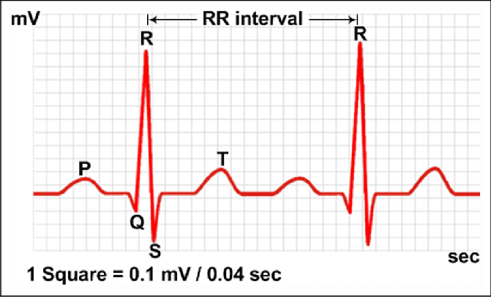
ECG Interpretation
Time Series Data divided into features
Divided into features such as:
P Waves
Q Waves
QRS Complex
R to R interval
(others)
What about the transitions between these features, how do we capture those?
What effect does imprecise preprocessing of ECG data have?
What subtleties might be missed that are necessary for diagnosis?
Does representing the raw data as an image capture these subtleties?
Lin, Chung-Chih & Yang, Chih-Yu & Zhou, Zhuhuang & Wu, Shuicai. (2018). Intelligent health monitoring system based on smart clothing. International Journal of Distributed Sensor Networks. 14. 1550147718794318. 10.1177/1550147718794318.

Slide 8
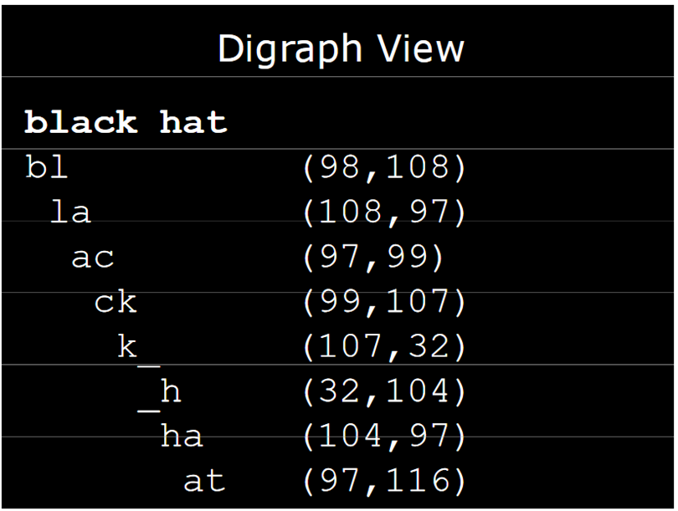
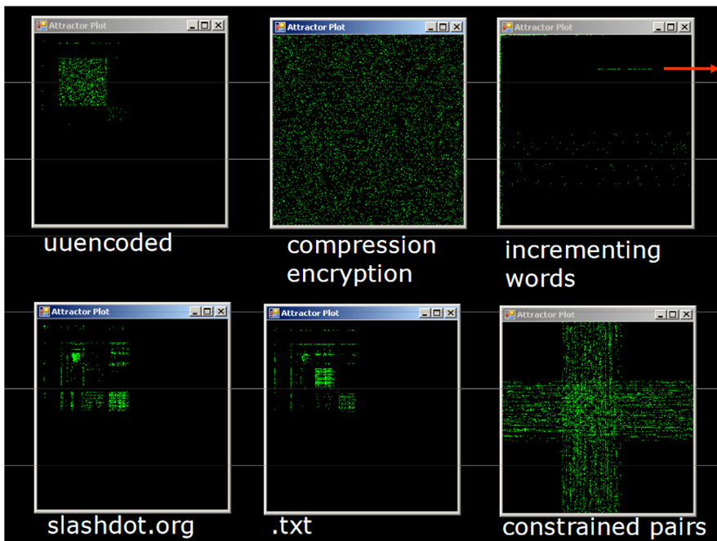
Emergent Qualities of Images
Images themselves introduce their own features (and challenges)
Greg, Conti. Dean, Erik. August 7, 2008. Visual Forensic Analysis and Reverse Engineering of Binary Data. [Powerpoint Slides] www.blackhat.com/presentations/bh-usa-08/Conti_Dean/BH_US_08_Conti_Dean_Visual_Forensic_Analysis.pdf

Slide 9
Learn ECG signals and their representations
Keep existing techniques that diagnose with raw ECG data
and
supplement with images and other data representations

Slide 10
Benefits and Impact (WHAT)
Global Impact of AI-Powered HCM Diagnosis
Enhanced Accuracy: Reduces false positives/negatives, ensuring reliable diagnosis.
Early Detection: AI's predictive capabilities facilitate timely intervention, preventing disease progression.
Patient Outcomes: Personalized treatment plans improve quality of life and survival rates.
Healthcare Systems: Streamlines diagnostic processes, reducing costs and resource burdens.
Global Care: Accessible technology bridges gaps in healthcare, offering benefits across diverse populations.

Slide 11
Deployment and Accessibility (HOW)
Azure Deployment & Global Reach
SaaS on Azure: Seamless integration enables real-time ECG analysis, making diagnosis instant and user-friendly.
Scalability: Azure's vast infrastructure supports expanding user base, handling increased data effortlessly.
Global Accessibility: Democratize HCM diagnosis with worldwide cloud-based solution
Balanced Business Model
Subsidized Access: Implement a tiered pricing strategy to allow low-cost or free services in underprivileged regions.
Revenue Generation: In affluent markets, charge appropriately to sustain operations and subsidize lower-income regions.
Global Health Equity: This approach promotes health equity, ensuring advanced diagnostics are not limited by geography or income. }
Sustainable Impact: A balanced financial model ensures long-term viability and continuous improvement of the service.
Global Health Alignment: Echoes global objectives of early, accurate disease diagnosis, reducing HCM-related mortalities.

Slide 12
Roadmap and Future Steps (HOW)
Development Roadmap & Future Goals
Immediate Milestones:
Q1-Q2: Model development, incorporating NIH guidelines.
Q3: Pilot testing in controlled environments.
Q4: Initial deployment on Azure, user feedback collection.
One-Year Goals:
Q1: Refinement based on feedback, start of clinical validation studies.
Q2-Q3: Integration with healthcare systems, expand user base.
Q4: Evaluate performance, plan for scaling.
Long-Term Vision:
Year 1-3: Expansion to encompass a full spectrum of cardiac conditions, leveraging the model's adaptability. A key focus will be on discovering previously unrecognized feature relationships, potentially serving as biomarkers for cardiac health.
Beyond: Continuous improvement, global outreach, and contribution to preventive healthcare.

Slide 13
Conclusion and Call to Action
Summary and Closing Remarks:
Key Points Recap: We introduced a cutting-edge AI model utilizing computer vision to diagnose Hypertrophic Cardiomyopathy (HCM) from 12-lead ECG images. This approach promises to overcome current diagnostic limitations, offering more accessible, accurate, and non-invasive solutions.
Global Impact: By improving diagnostic accuracy and enabling early detection, this model has the potential to significantly enhance patient outcomes, reduce healthcare costs, and make a transformative impact on global cardiac health.
Call to Action: We're excited about the possibilities and invite collaboration, support, and constructive feedback. Together, we can revolutionize cardiac care and save countless lives.

Slide 14
Thank You and Q&A
Thank you for the opportunity to share our vision with you today. As we stand on the brink of a transformative era in cardiac healthcare, we envision our AI software not merely as a tool, but as a harbinger of comprehensive change, enhancing patient care across all frontiers.
We welcome your thoughts, collaboration, and support in this endeavor. Should our project resonate with you, we invite you to connect with us:
John Pearce
Jared Schneider
John.Pearce@ainnovetion.com

